Slide 1


Future of Electricity
@rejipillai

Slide 2
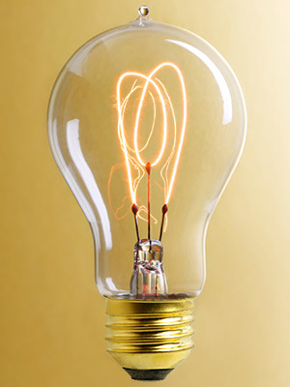
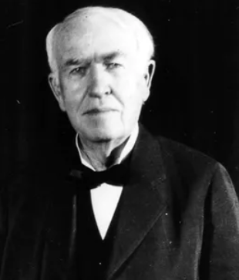
Electricity and the Electric Grid Changed the World!
“We will make electricity so cheap that only the rich will burn candles.”
- Thomas Alva Edison
Image Credit : pinterest
Image Credit : Inverse

Slide 3



Electricity touches our daily life in many ways
Today we can’t imagine life without electricity!
Yet one billion people have no access to electricity
It is the CLEANEST FUEL at USER END
Image Credit: Shutterstock
Image Credit: Iconfinder
Image Credit: 123rf.com

Slide 4
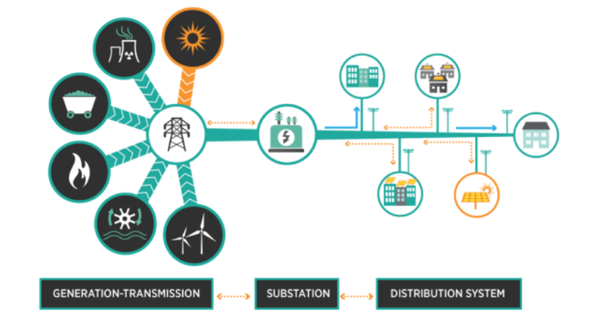
How electricity reaches your home?
Image Credit: www.energy.gov

Slide 5
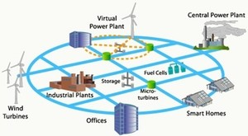
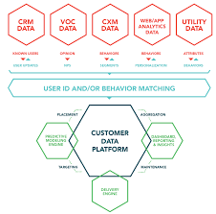
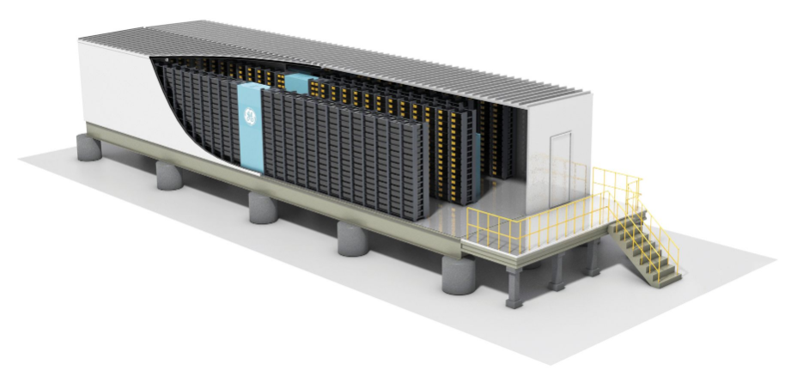
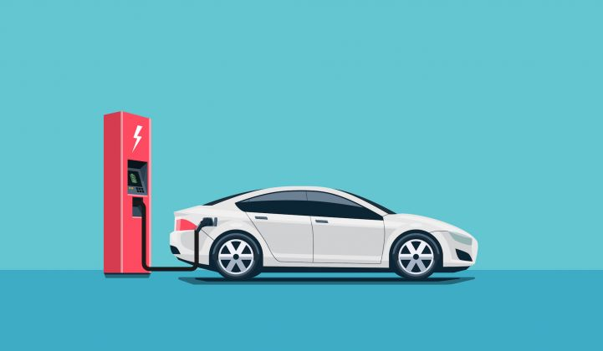
Changing Grid – New Technologies, New Players
Image Credit: betterworldsolutions.eu
Image Credit: chittagongit.com
Traditional Grid evolving as Integrated Grid
Aggregators
Community Energy Storage
EVs, V2G
Image Credit: GE
Image Credit: Garage Centraal Aruba

Slide 6
Rapidly Changing Energy Mix on the Grid
Year | Installed Power Capacity (MW)
 | Global Total (Approx.) | Solar | Wind
2000 | 3,500,000 | 1,224 (0.035%) | 17,333 (0.5%)
2018 | 5,500,000 | 389,572 (7.08%) 318 times growth | 513,547 (9.34%) 29 times growth

Slide 7
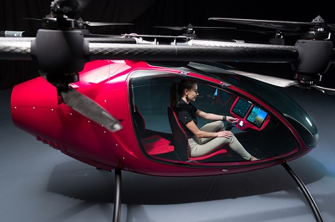
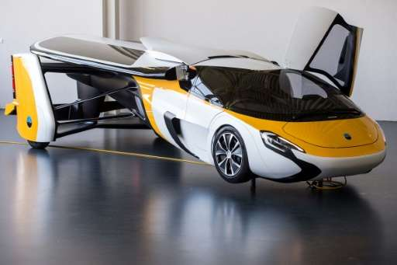

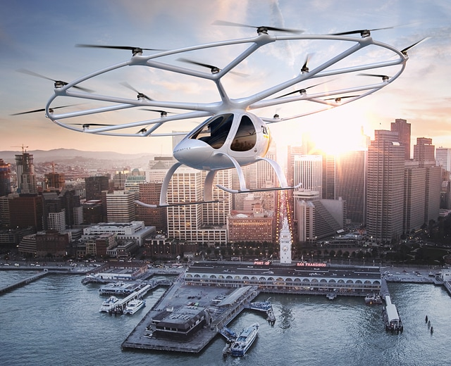
Electrification of Transportation
All these Aerial Vehicles are powered by electricity!
How to charge the flying machines?
Image Credit: WeTalkUAV.Com
Image Credit: Daily Star
Passenger Drone
Hybrid Flying Car
Image Credit: chittagongit.com
Image Credit: volocopter.com
Delivery Drone
Volocopter

Slide 8
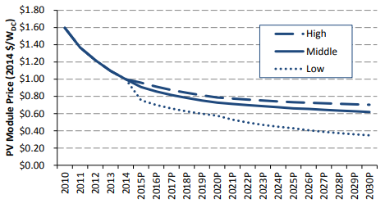
Solar PV Price Projections
2010: $1.6/Watt
2018: $0.8/Watt
(50% reduction)
2030: $0.35/Watt
(78% reduction)
Source: NREL

Slide 9
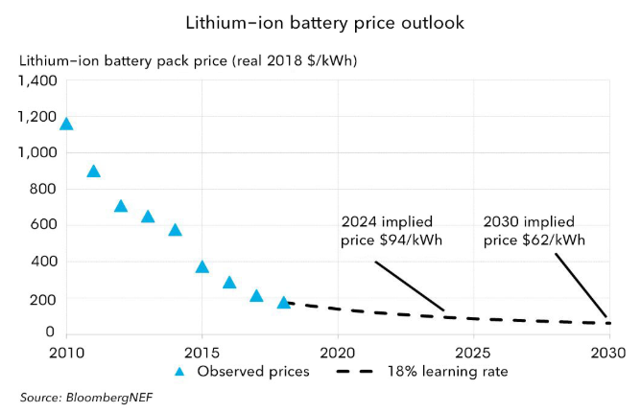
Lithium-ion Battery Pack Price Projections
2010: $1200/kWh
2018: $200/kWh
(83% reduction)
2024: $94/kWh
(92% reduction)
2030: $62/kWh
(95% reduction)
Source: BNEF

Slide 10
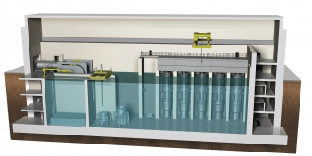
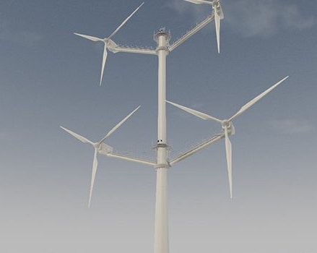
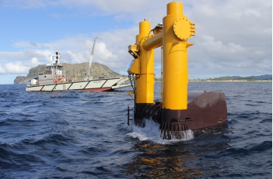
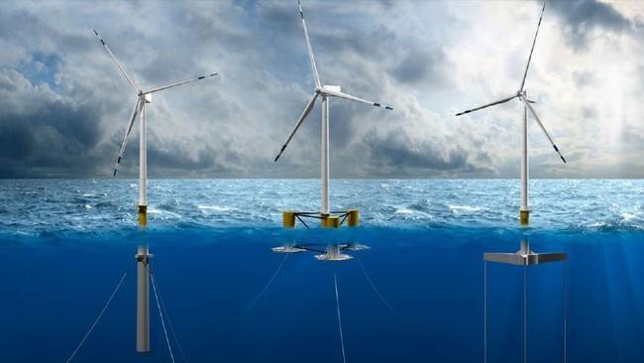
New Generation Technologies on the Horizon
Advanced Small Modular Nuclear Reactor
Multi-blade Wind Turbine
Image Credit: www.energy.gov
Image Credit: www.businessgreen.com
Wave Energy Convertor
Floating Wind Turbines
Image Credit: www.energy.gov
Image Credit: www.energy.gov

Slide 11
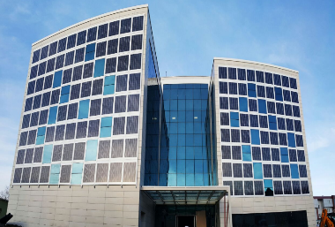
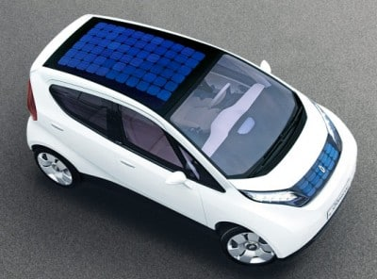

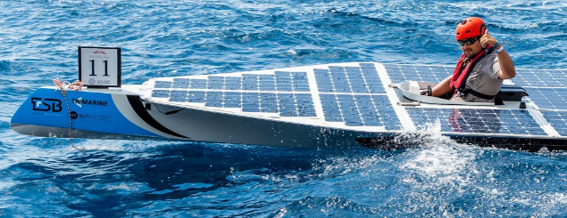


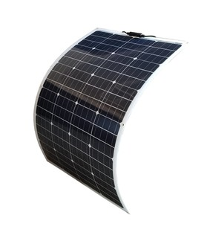
Solar Energy Revolution
Building Integrated PV
Solar Vehicle
Image Credit: Ankara Solar
Image Credit: www.cartrade.com
Solar Umbrella
Spray-on Solar Cells
Solar Boat
Image Credit: www.gizmodo.com
Image Credit: EnergySage
Image Credit: Técnico Lisboa - Universidade de Lisboa
Solar Vests and other clothing
High Efficiency Solar Cells
Image Credit: Windy Nation
Image Credit: Geeky Gadgets

Slide 12

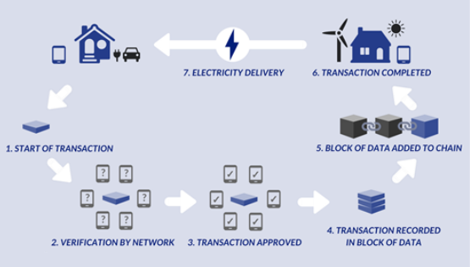
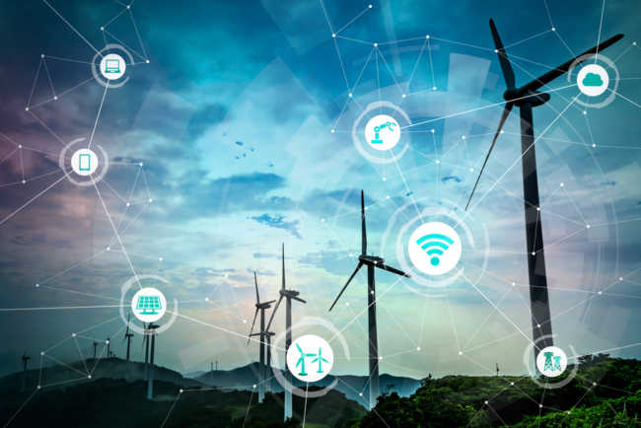
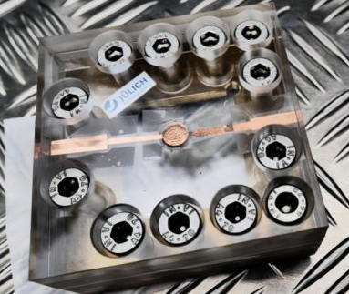
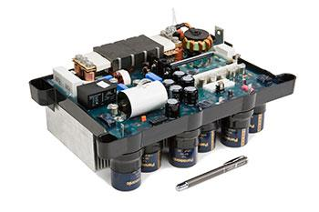

Disruptive Technologies on the Grid
Image Credit: k-png
Smart Microgrids and DC Grids
Image Credit: Parth Infosystems
Image Credit: Shutterstock
P2P Power Trading on Blockchain
Digitalization
Image Credit: ScienceDaily
Image Credit: Polytechnic Hub
Image Credit: mckinsey.com
Solid State Battery
Solid State Transformer
AI and RPA

Slide 13
Journey from Consumer to Nonsumer
Prosumer
Prosumager
Nonsumer
Customer
Consumer

Slide 14
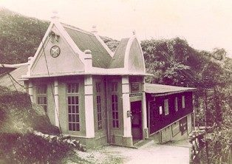

India’s Tryst with Electrification
1898: 130kW Sidrapong Hydroelectric Power Station in Darjeeling
Image Credit: indiangorkhas.in
1899: 1 MW thermal plant in Kolkata
1902: Electric Trams in Kolkata
Image Credit: CESC

Slide 15
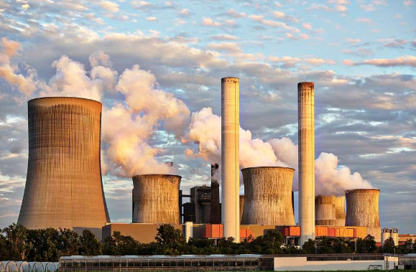

Independent India - Electricity Development
Image Credit: Thermodyne Boilers
Image Credit : Natali_Mis | Getty Images
Installed Capacity:
1947: 1.36 GW
2019: 357 GW
Per capita Consumption:
1947: 16.3 kWh
2018: 1149 kWh

Slide 16



One Nation – One Grid
3rd
India is the 3rd largest power system in the world
Modern Transmission System
800 kV and 500 kV HVDC Lines
765 kV and 400 kV AC Lines
Image Credit : free-icon-rainbow.com
Electrification
619000 villages and 99.99% households electrified
25 million households electrified in last 18 months
357 GW, 300 million customers One Grid covering >3 million SqKm operating in one frequency
Image Credit : k-png

Slide 17
Installed Power Capacity and Annual Energy Consumption in Top 5 Countries
Rank | Country | Installed Power Capacity (MW) | Annual Energy Consumption (BU)
1. | China | 1,899,670 (2018) | 6,529,000
2. | USA | 1,202,783 (2018) | 4,251,000
3. | India | 357,162 (2019) | 1,541,000
4. | Japan | 335,636 (2016) | 1,101,000
5. | Russia | 263,500 (2015) | 1,090,000
Sources: Statista, Edison Electric Institute, CEA, undata, CIA Factbook, Enerdata: Global Energy Statistical Yearbook 2018

Slide 18
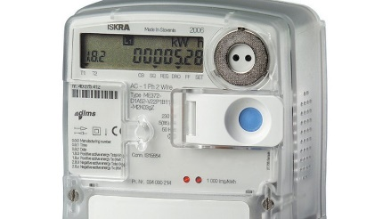
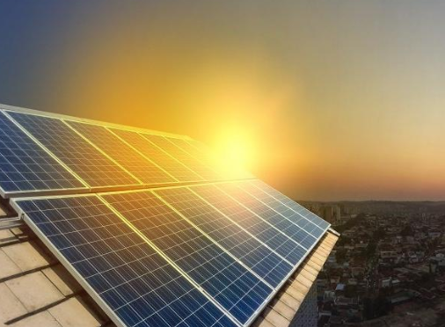
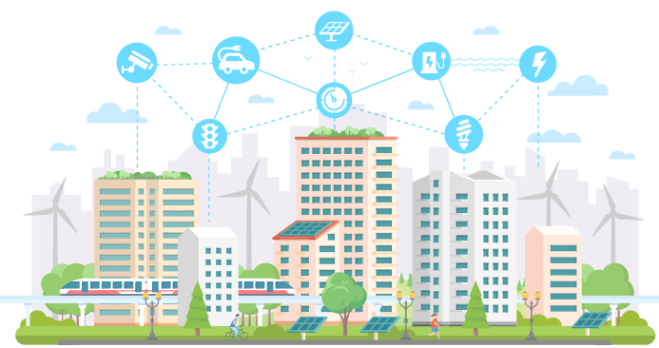

India: Huge Opportunities for Business and Innovation
300 million Smart Meters in next 5 years
350 GW Solar PV by 2032
Image Credit : RTE
Image Credit : The Hindu Business Line
6-7 million EVs in next 5 years
100 Smart Cities
Image Credit : BC Hydro
Image Credit : ScienceSoft

Slide 19
“ELECTRICITY + COMMUNISM = SOCIALISM” – V.I. Lenin 1920
“ONE SUN - ONE EARTH - ONE GRID”
Narendra Modi 2018

